Slide 1

Investigating Violent Crime A Human Issue Group 14

Slide 2
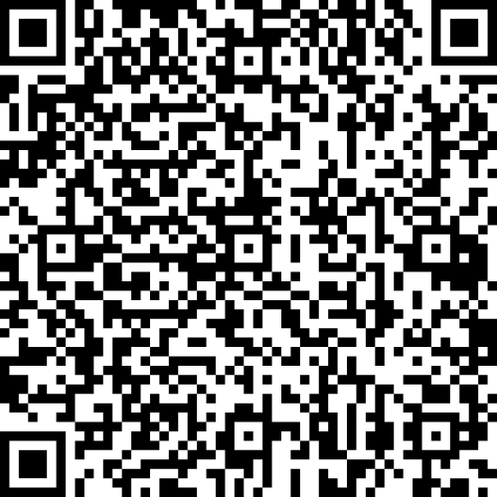

It looks like you’re trying to scan a QR code. To do this:
Open Camera

Slide 3

Purpose of Study
Based on significant factors, identify potential problems
Investigate the factors that are related to violent crime
Influence policy makers
Update and compile existing datasets
Identify safe and dangerous counties

Slide 4
Data Information
Collection
Data Years
Violent Crime
Violent Crime
2016
2016
County-level for 50 U.S. states
(Territories not included)
County-level for 50 U.S. states
(Territories not included)
Locations
Locations
Population
Population
2020
2020
Police Force Numbers
Police Force Numbers
2022
2022
Race
Race
2016
Master Data File
2016
Master Data File
Combined 60 individual datasets
Combined 60 individual datasets
Party Affiliation
Party Affiliation
2014
2014
Internet Access
Internet Access
2013
2013
United States government organizations and independent centers
United States government organizations and independent centers
Annual Income
Annual Income
2022
Sources
2022
Sources
Age Range
Age Range
2020
2020

Slide 5
Data Information, Continued
Total 3,143 US Counties
Datasets
Collection
2,525 counties with violent crime data
Datasets
Datasets
Note Datasets organized by FIPS
Datasets

Slide 6
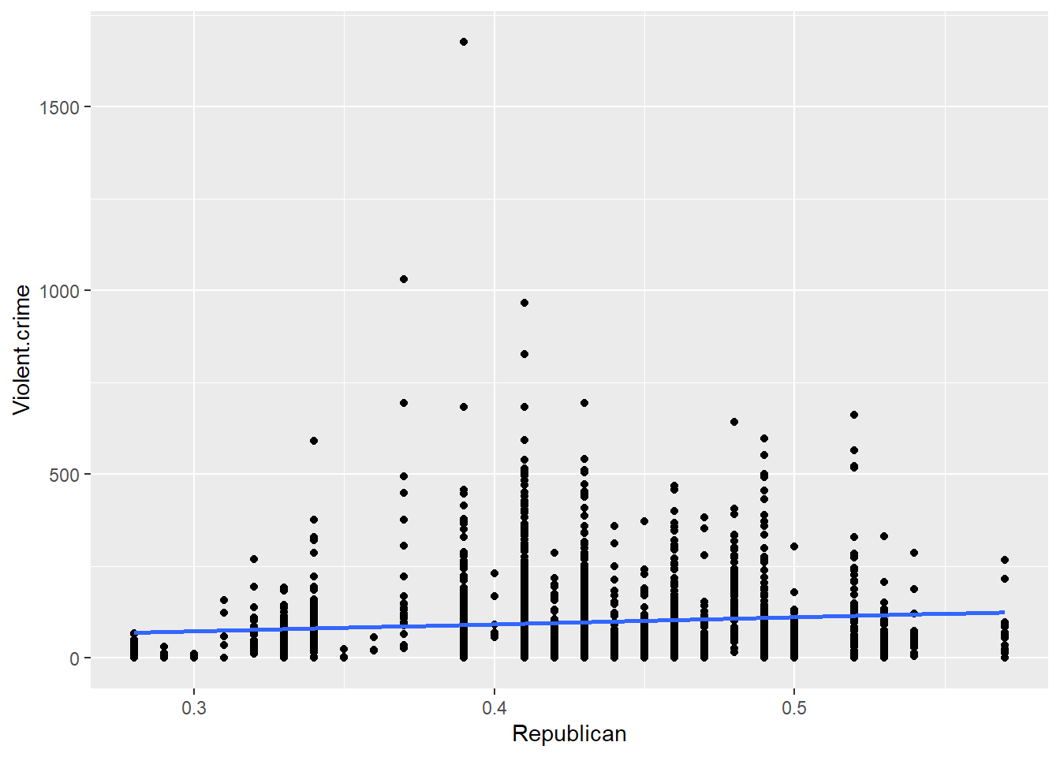
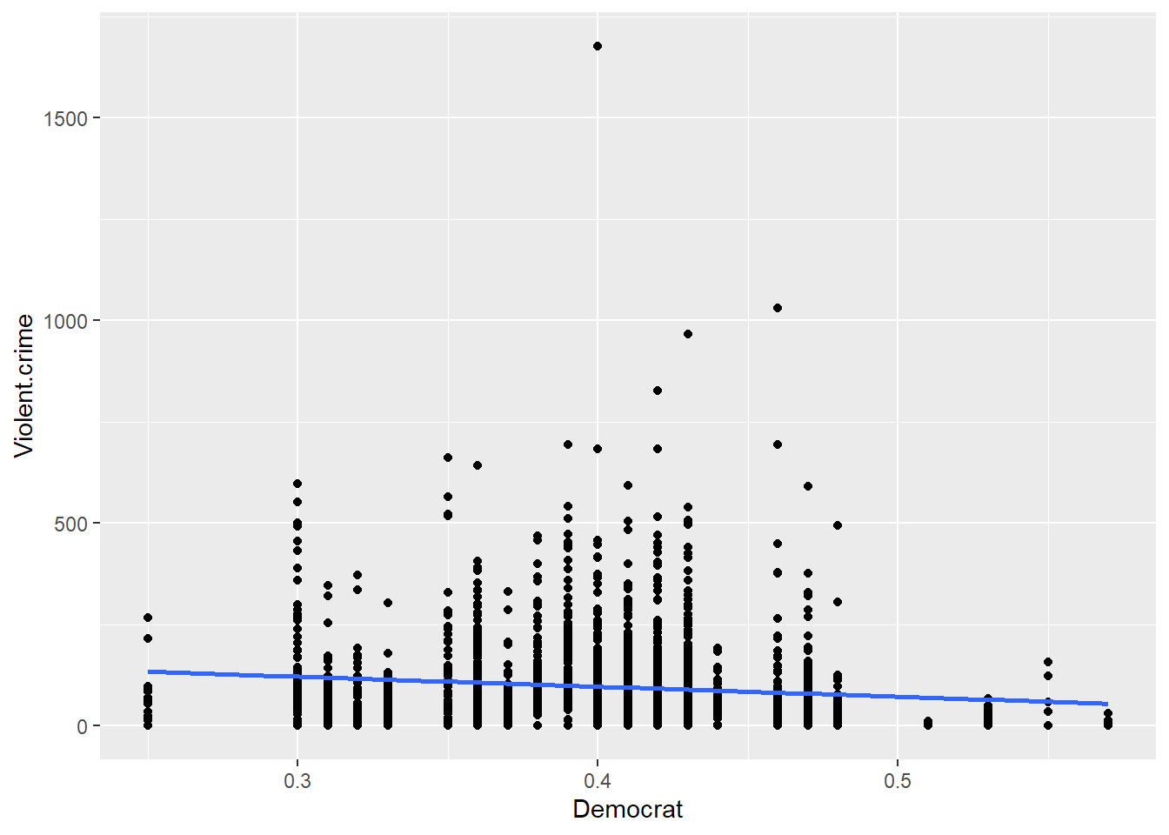
Exploratory Data Analysis (EDA 1 of 4)
Sorting Violent Crime Based on Party Affiliation
Note Models crime per 100,000 population

Slide 7
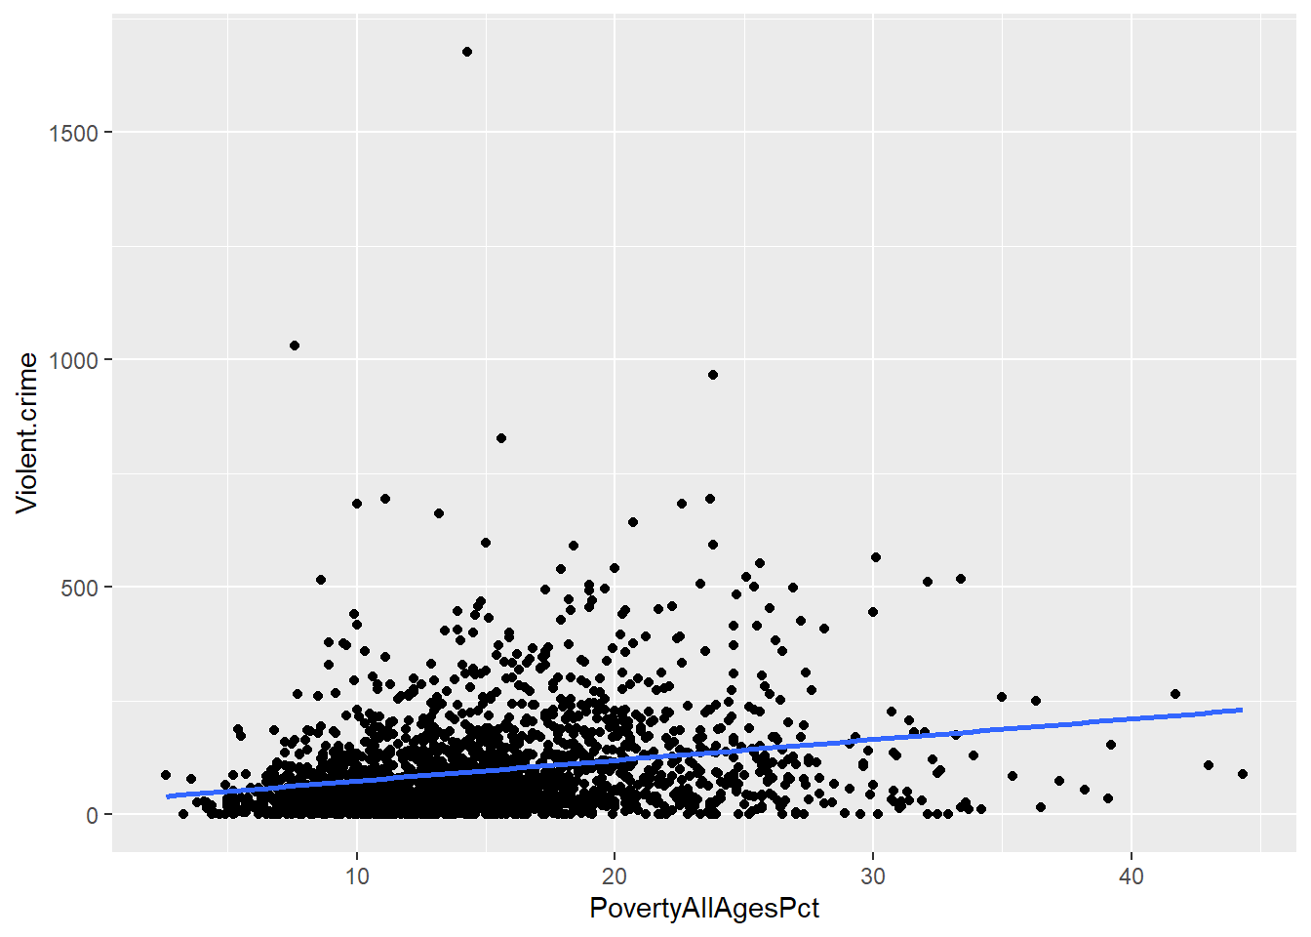
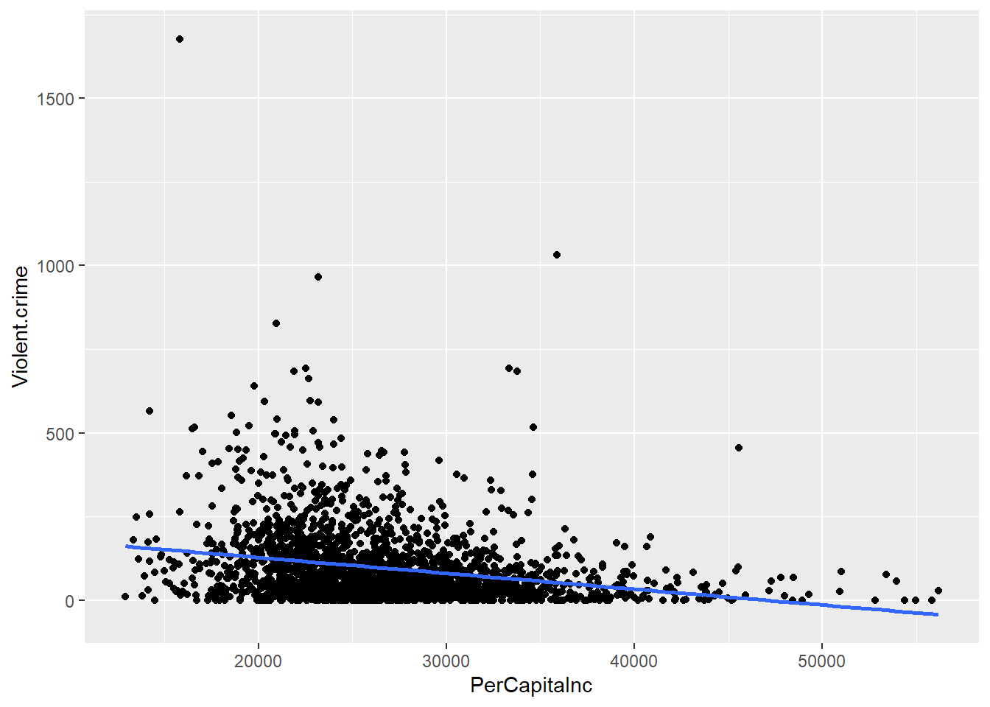
Exploratory Data Analysis (EDA 2 of 4)
Sorting Violent Crime Based on Income
Note Models crime per 100,000 population

Slide 8
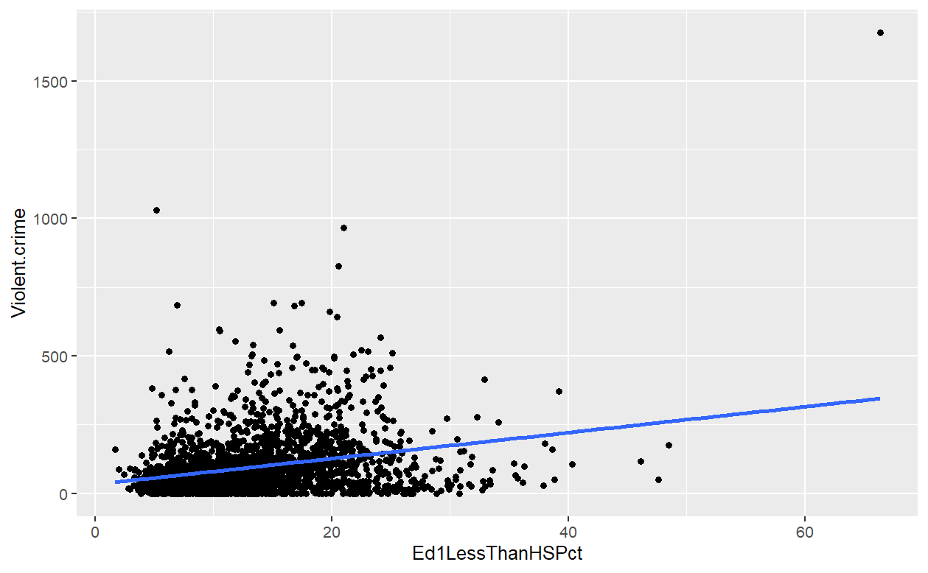
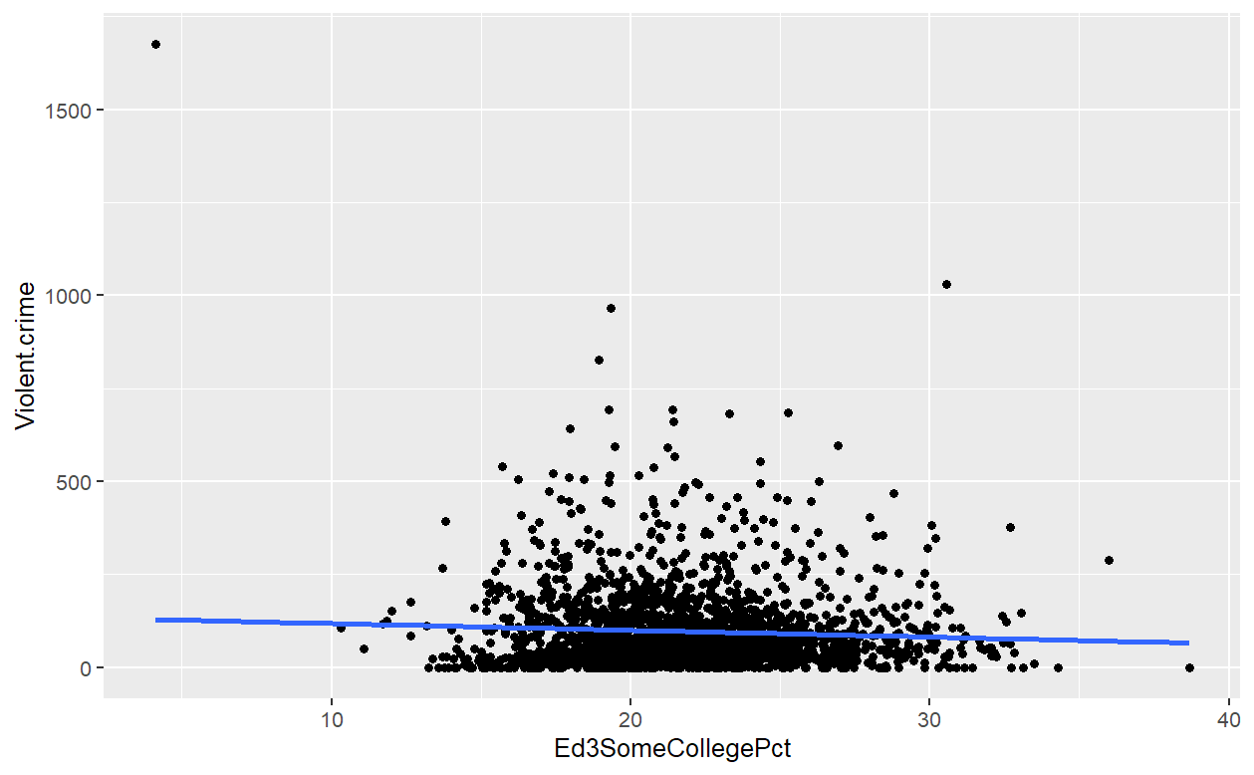
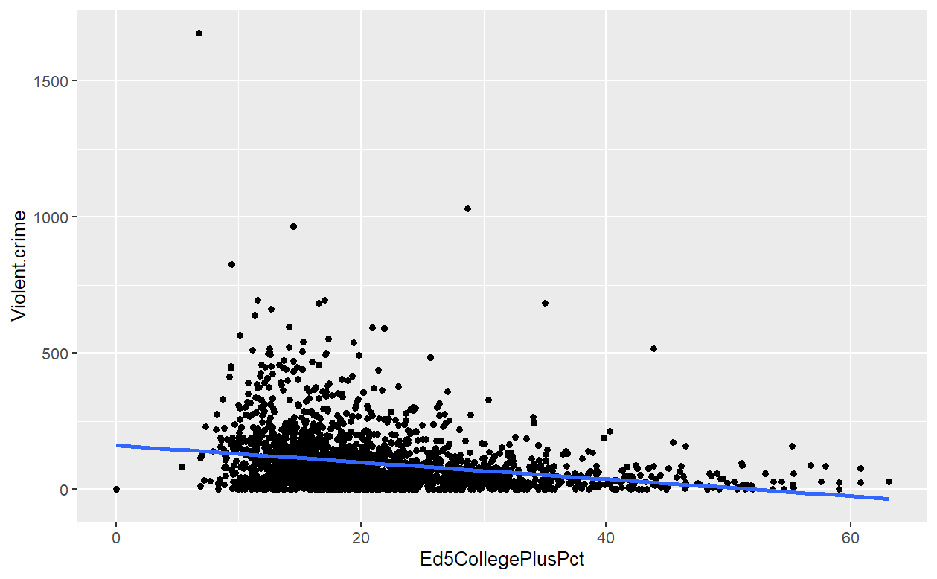
Exploratory Data Analysis (EDA 3 of 4)
Sorting Violent Crime Based on Education Level
Less than HS
Some College
College+
Less than HS

Slide 9
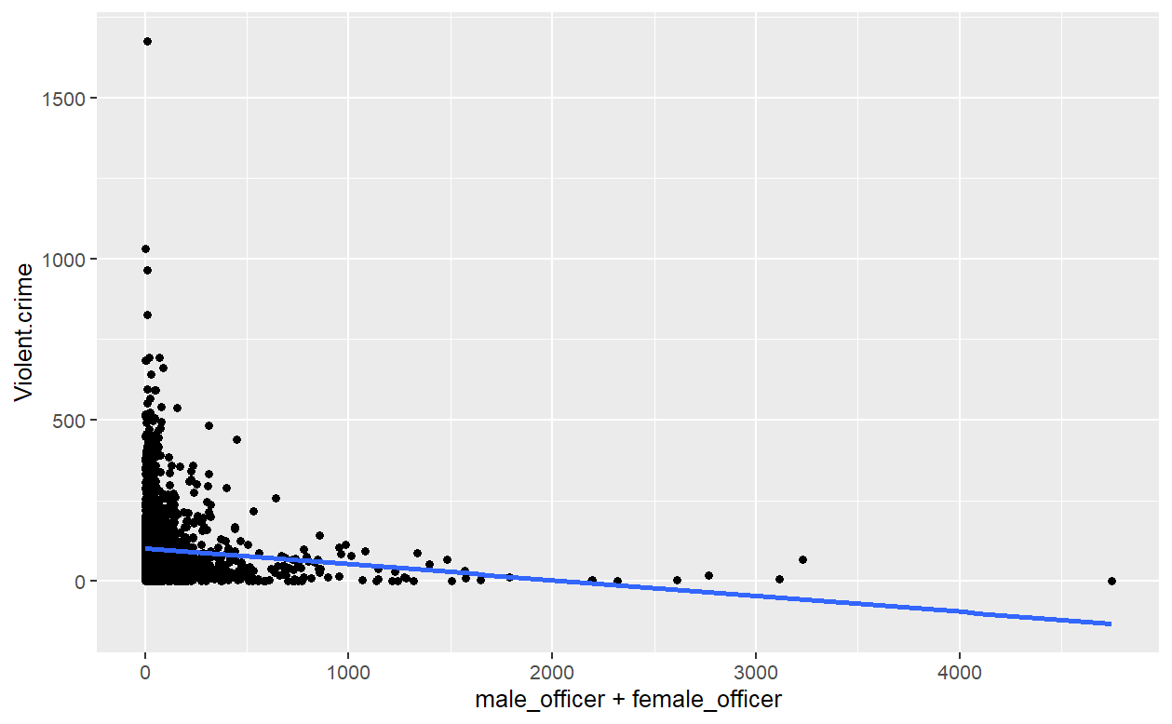
Exploratory Data Analysis (EDA 4 of 4)
Sorting Violent Crime Based on Law Enforcement Count
Interpretation of EDA
While fitting some of the data well, the large residuals indicate that no one factor predicts the data
The data is consistent with our expectations

Slide 10
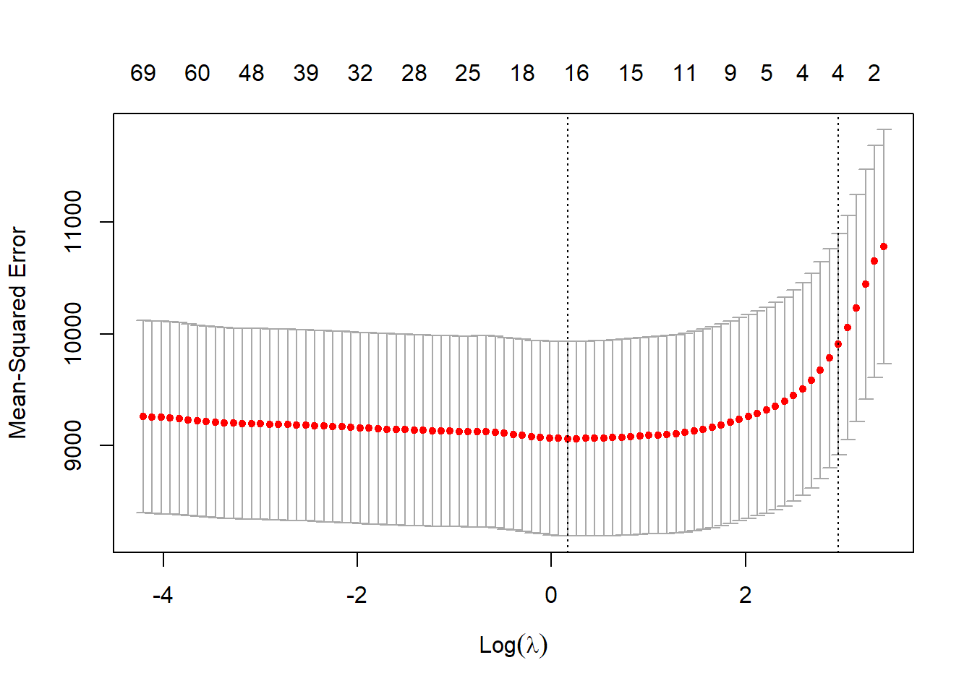
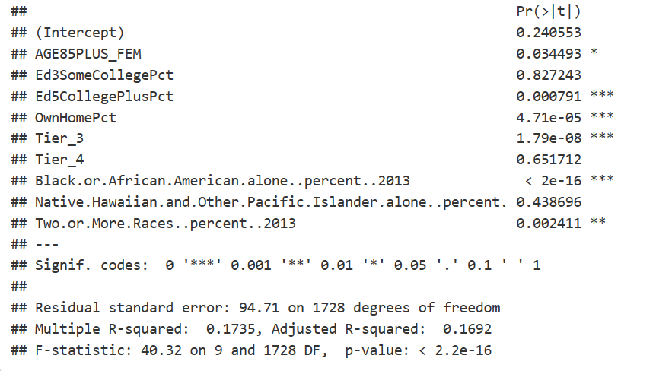
Relaxed LASSO Model
Log Lambda from LASSO Cross Validation
Significant Variables

Slide 11
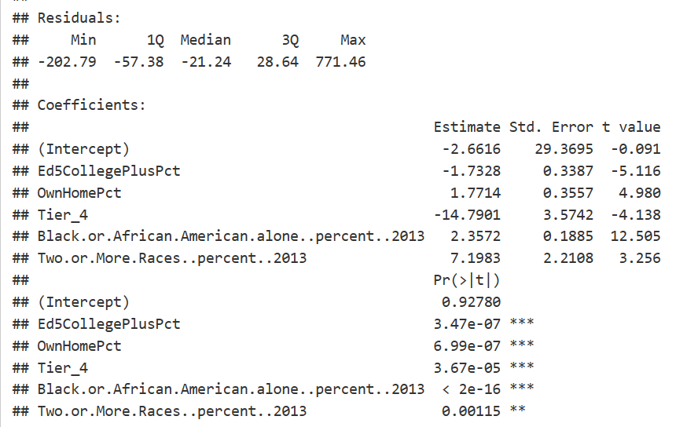
Final LASSO Model
Backward Selection on LASSO Output
Interpretation
Factors with a positive correlation with violent crime rate: percentage of homeowners, black/African American and mixed-race population rate.
Factors that cause the average crime rate to decrease as they increase: percentage of people with college+ degrees and high-speed Internet access.

Slide 12
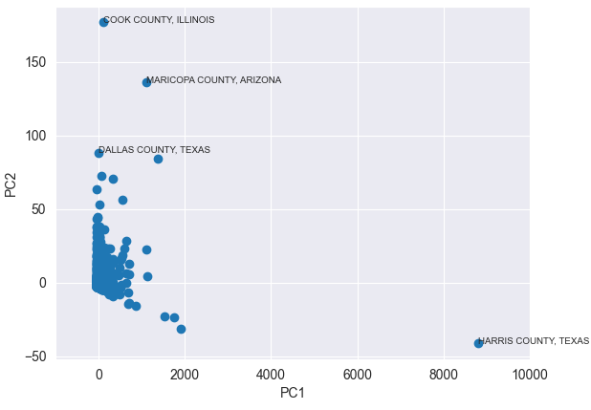
Clustering of Counties
Outliers & Leverage Points
Harris County
Texas
Dallas County
Texas
Cook County
Illinois
Maricopa County
Arizona

Slide 13



Feature Engineering
Extracting useful features from the raw data to improve prediction quality
There are more than a hundred age-related features. We trim them down to only eight without affecting the quality of model predictions.
Age
Removing this feature results in improvements in the performance of various models.
Party Affiliation
This variable is skewed to the right. We applied logarithmic transform so that it follows a normal distribution.
Population Estimate

Slide 14
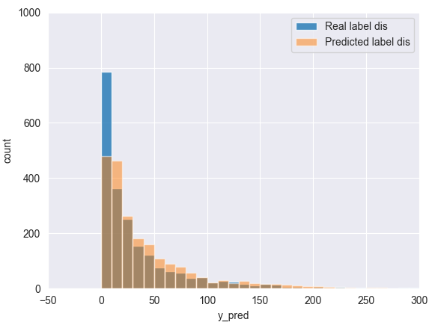



Random Forest
Fitting multiple decision trees and averaging their decisions to predict the number of violent crimes
Description
Robustness, Accuracy
Pros
Interpretability, Training Time
Cons

Slide 15
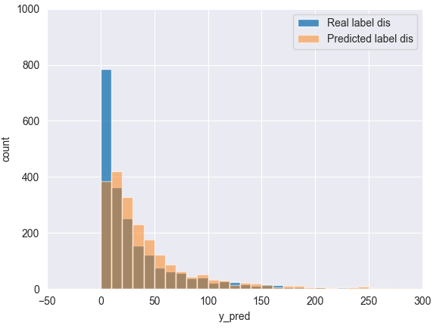


Gradient Boosting
Fitting multiple decision trees with each tree improving upon the result of the previous trees
Description
A
B
Better accuracy than Random Forest
Pros
A
Gradient Boosting
B
XGBoost
Bad with noisy data, Overfitting
Cons
C
LightGBM
C

Slide 16


Ensemble Models
Combining previous models together and averaging their decisions
GB + RF + Ridge
Description
Generalization (Low Variance)
Pros
High Training Time, Tuning
GB + RF + Ridge + LGBM
Cons

Slide 17
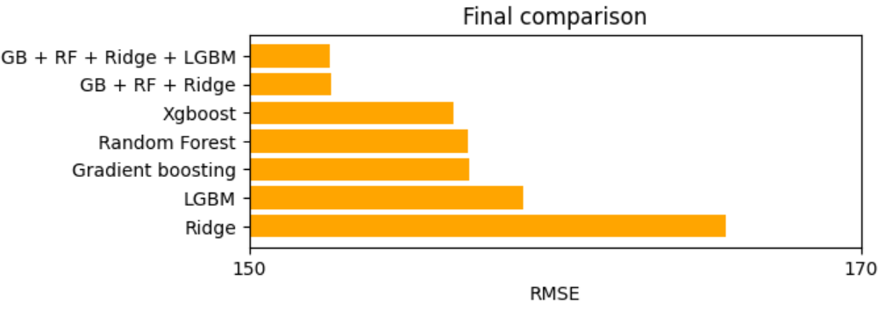
Final Comparison
Key
GB: Gradient Boosting
RF: Random Forest
LGBM: Light Gradient Boosting Machine
XGBoost: Extreme Gradient Boosting
Note RMSE is determined by 5-fold cross validation

Slide 18
Mean Example
All Factors Predicted
POPESTIMATE
NumUnemployed2019
BlackOrAfricanAmericanalone percent2013
AGE45_64
PerCapitaInc
Housing_Units
AmericanIndianandAlaskaNativealonepercent2013
AGE64
Immigration_Rate_2000_2010
Tier_1
Asianalonepercent2013
Results
Ed1LessThanHSPct
Tier_2
NativeHawaiianandOtherPacificIslanderalongpercent
Using all means, the number of crimes for the average US county is 72.782 per 100,000.
Ed3SomeCollegePct
Tier_3
TwoorMoreRacespercent2013
Ed5CollegePlusPct
Tier_4
WhitealonenotHispanicorLatinopercent2013
Based on our model, we computed the number of crimes for the average American county.
OwnHomePct
female_officer
AGE0_24
male_officer
DiversityIndex
AGE25_44

Slide 19




Remarks
Internet access is strongly negatively correlated with violent crime.
Access to higher education also has a strong negative correlation with violent crime.
Home ownership is strongly related to an increase in violent crime.
Race continues to have a significant correlation with violent crime.
Notes:
Access to higher education has a strong negative correlation with violent crime – this can be easily understood in that higher education lowers violence, where discrimination is lowered and accepting others.
We suspect this may be caused from more time spent online and leading to less motivation to commit violent crimes. The negative coefficient for this variable might also challenge the idea that video games contribute to violent crimes, though more investigations are required.
One possible explanation for this might be that more housing allows for domestic violence or hate crimes.
We suspect there may be greater socio-economic factors that lead to these issues such as unequal opportunities or historical impacts.

Slide 20



Appendix
All datasets can be found in the project GitHub along with all files and models
Datasets
Potential response variables that can be modeled with the inputs: "Violent Crime”, "Murder and Manslaughter”, "Rape”, "Robbery”, "Aggravated Assault”, "Property Crime”, "Burglary”, "Larceny-Theft”, "Motor Vehicle Theft"
Response Variables
The final dataset can be found on Kaggle
Kaggle

